Slide 1
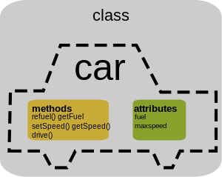

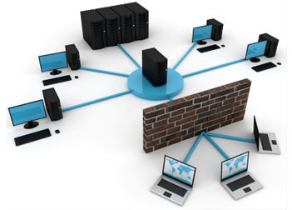

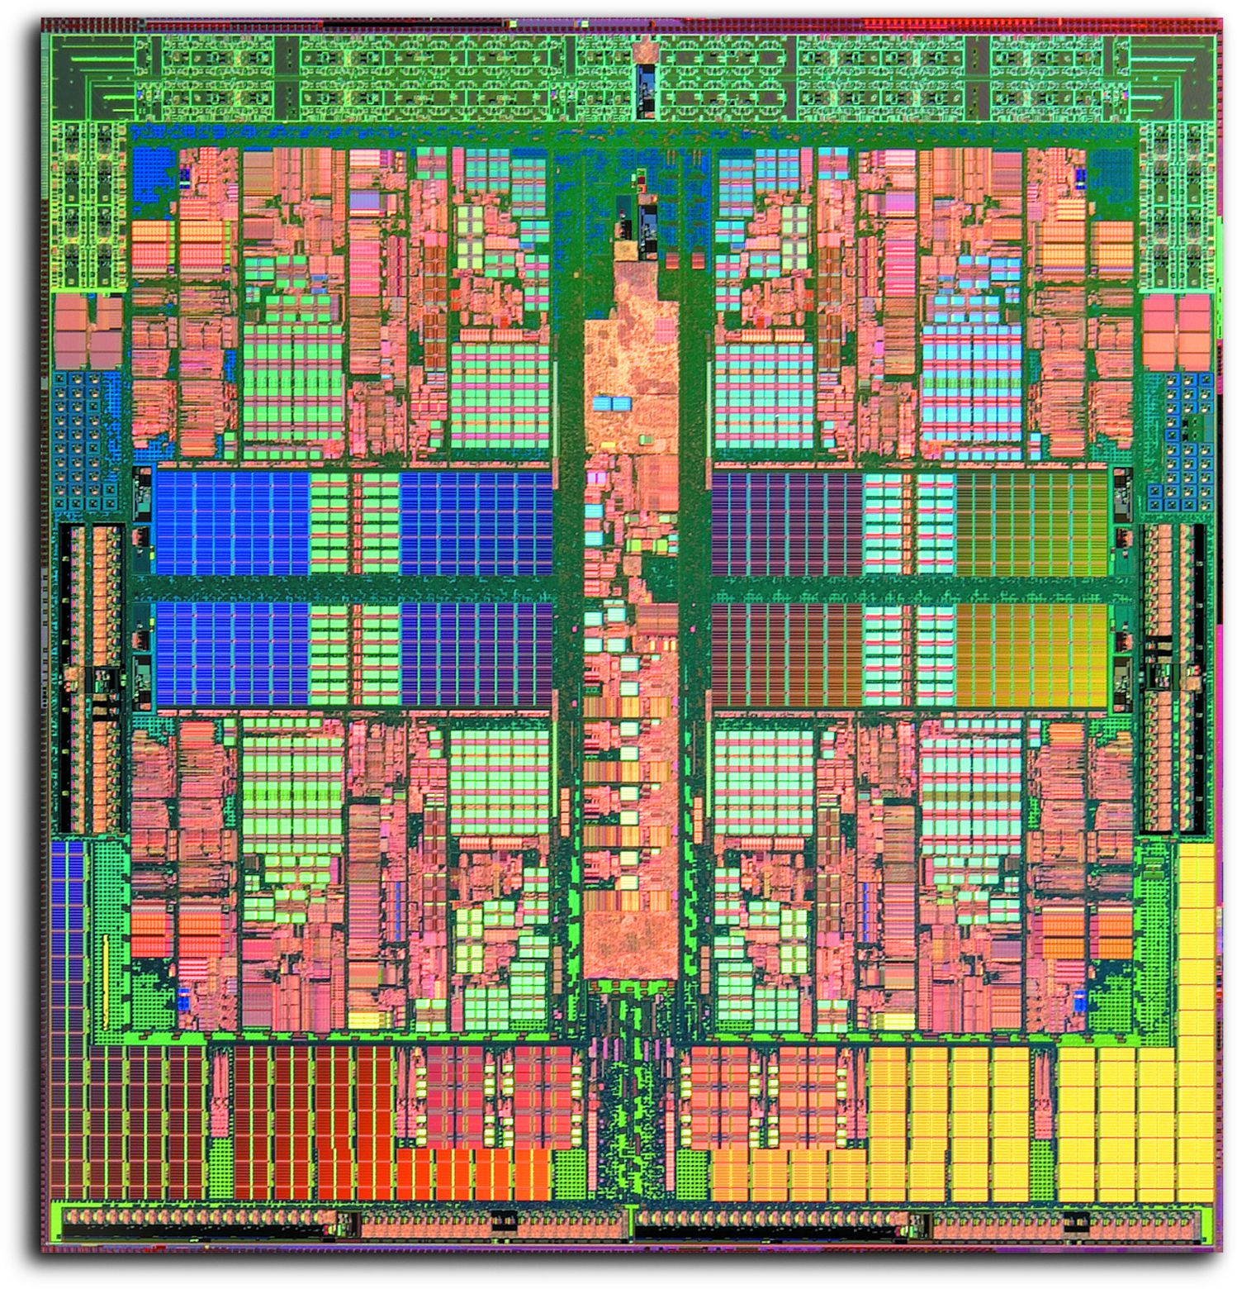




Slide 2
Drexel University
College of Computing and Informatics
Drexel University
College of Computing and Informatics

